Slide 1
COSC3503 Section 1 Operating Systems Chapter 5 Process Synchronization
Doug Lim

Slide 2
Chapter 5 Process Synchronization Topics
Background
The Critical-Section Problem
Peterson’s Solution
Synchronization Hardware
Mutex Locks
Semaphores
Classic Problems of Synchronization
Monitors
Synchronization Examples
Alternative Approaches

Slide 3
Background
Processes can execute concurrently
May be interrupted at any time, partially completing execution
Concurrent access to shared data may result in data inconsistency
Maintaining data consistency requires mechanisms to ensure the orderly execution of cooperating processes
Illustration of the problem: Suppose that we wanted to provide a solution to the consumer-producer problem that fills all the buffers. We can do so by having an integer counter that keeps track of the number of full buffers. Initially, counter is set to 0. It is incremented by the producer after it produces a new buffer and is decremented by the consumer after it consumes a buffer.

Slide 4
Producer
while (true) { /* produce an item in next produced */
while (counter == BUFFER_SIZE) ;
/* do nothing */
buffer[in] = next_produced;
in = (in + 1) % BUFFER_SIZE;
counter++;
}

Slide 5
Consumer
while (true) {
while (counter == 0)
; /* do nothing */
next_consumed = buffer[out];
out = (out + 1) % BUFFER_SIZE;
counter--;
/* consume the item in next consumed */
}

Slide 6
Race Condition
counter++ could be implemented as register1 = counter register1 = register1 + 1 counter = register1
counter-- could be implemented as register2 = counter register2 = register2 - 1 counter = register2
Consider this execution interleaving with “count = 5” initially:
S0: producer execute register1 = counter {register1 = 5} S1: producer execute register1 = register1 + 1 {register1 = 6} S2: consumer execute register2 = counter {register2 = 5} S3: consumer execute register2 = register2 – 1 {register2 = 4} S4: producer execute counter = register1 {counter = 6 } S5: consumer execute counter = register2 {counter = 4}

Slide 7
Critical Section Problem
Consider system of n processes {p₀, p₁, … p_{n-1}}
Each process has critical section segment of code
Process may be changing common variables, updating table, writing file, etc
When one process in critical section, no other may be in its critical section
Critical section problem is to design protocol to solve this
Each process must ask permission to enter critical section in entry section, may follow critical section with exit section, then remainder section

Slide 8
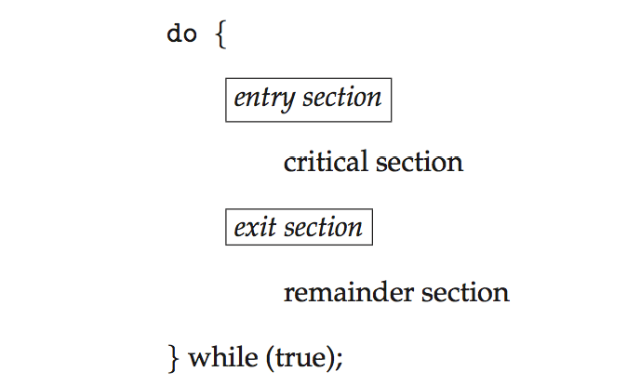
Critical Section

Slide 9
Requirements to Critical-Section Problem
Mutual Exclusion - If process P_{i} is executing in its critical section, then no other processes can be executing in their critical sections
Progress - If no process is executing in its critical section and there exist some processes that wish to enter their critical section, then the selection of the processes that will enter the critical section next cannot be postponed indefinitely
Bounded Waiting - A bound must exist on the number of times that other processes are allowed to enter their critical sections after a process has made a request to enter its critical section and before that request is granted
Assume that each process executes at a nonzero speed
No assumption concerning relative speed of the n processes

Slide 10
Critical-Section Handling in OS
Two approaches depending on if kernel is preemptive or non- preemptive
Preemptive – allows preemption of process when running in kernel mode
Non-preemptive – runs until exits kernel mode, blocks, or voluntarily yields CPU
Essentially free of race conditions in kernel mode

Slide 11
Peterson’s Solution
Good algorithmic description of solving the problem
Two process solution
Assume that the load and store machine-language instructions are atomic; that is, cannot be interrupted
The two processes share two variables:
int turn;
Boolean flag[2]
The variable turn indicates whose turn it is to enter the critical section
The flag array is used to indicate if a process is ready to enter the critical section. flag[i] = true implies that process P_{i} is ready!

Slide 12
Peterson’s Solution Algorithm
do {
flag[i] = true;
turn = j;
while (flag[j] && turn = = j);
critical section
flag[i] = false;
remainder section
} while (true);

Slide 13
Peterson’s Solution Provable
Provable that the three Critical Solution requirement are met:
1. Mutual exclusion is preserved
P_{i} enters CS only if:
either flag[j] = false or turn = i
2. Progress requirement is satisfied
3. Bounded-waiting requirement is met

Slide 14
Synchronization Hardware
Many systems provide hardware support for implementing the critical section code.
All solutions below based on idea of locking
Protecting critical regions via locks
Uniprocessors – could disable interrupts
Currently running code would execute without preemption
Generally too inefficient on multiprocessor systems
Operating systems using this not broadly scalable
Modern machines provide special atomic hardware instructions
Atomic = non-interruptible
Either test memory word and set value
Or swap contents of two memory words

Slide 15
Solution to Critical-section Problem Using Locks
do {
acquire lock
critical section
release lock
remainder section
} while (TRUE);

Slide 16
Test-And-Set Instruction
Definition:
boolean test_and_set (boolean *target)
{
boolean rv = *target;
*target = TRUE;
return rv:
}
Executed atomically
Returns the original value of passed parameter
Set the new value of passed parameter to “TRUE”.

Slide 17
Solution using test_and_set()
Shared Boolean variable lock, initialized to FALSE
Solution:
do { while (test_and_set(&lock))
; /* do nothing */
/* critical section */
lock = false;
/* remainder section */
} while (true);

Slide 18
Compare-And-Swap Instruction
Definition:
int compare _and_swap(int *value, int expected, int new_value) {
int temp = *value;
if (*value == expected) {
*value = new_value;
}
return temp;
}
Executed atomically
Returns the original value of passed parameter “value”
Set the variable “value” the value of the passed parameter “new_value” but only if “value” ==“expected”. That is, the swap takes place only under this condition.

Slide 19
Solution using compare_and_swap
Shared integer “lock” initialized to 0;
Solution:
do { while (compare_and_swap(&lock, 0, 1) != 0)
; /* do nothing */
/* critical section */
lock = 0;
/* remainder section */
} while (true);

Slide 20
Bounded-waiting Mutual Exclusion with test_and_set
do { waiting[i] = true; key = true; while (waiting[i] && key)
key = test_and_set(&lock);
waiting[i] = false;
/* critical section */
j = (i + 1) % n;
while ((j != i) && !waiting[j])
j = (j + 1) % n;
if (j == i)
lock = false;
else
waiting[j] = false;
/* remainder section */
} while (true);
Notes:
waiting[], key, and lock initialized to false.
First task to reach test_and_set will get a value of false and proceed.
After critical section if nobody is waiting lock is set to false and we go back to the original situation, otherwise we change the not waiting process to the next waiting process up from us and leave the lock set.
Progress is made because the lock is released or a waiting process is set to not waiting in the list.
Bounded because if a process is waiting, it will wait a most (n-1) turns to get a turn.

Slide 21
Mutex Locks
Previous solutions are complicated and generally inaccessible to application programmers
OS designers build software tools to solve critical section problem
Simplest is mutex lock
Protect a critical section by first acquire() a lock then release() the lock
Boolean variable indicating if lock is available or not
Calls to acquire() and release() must be atomic
Usually implemented via hardware atomic instructions
But this solution requires busy waiting
This lock therefore called a spinlock

Slide 22
Semaphore
Synchronization tool that provides more sophisticated ways (than Mutex locks) for process to synchronize their activities.
Semaphore S – integer variable
Can only be accessed via two indivisible (atomic) operations
wait() and signal()
Originally called P() and V()
Definition of the wait() operation
wait(S) {
while (S <= 0)
; // busy wait
S--;
}
Definition of the signal() operation
signal(S) {
S++;
}

Slide 23
Semaphore Usage
Counting semaphore – integer value can range over an unrestricted domain. Often used to manage a set of resources with a finite number of instances.
Binary semaphore – integer value can range only between 0 and 1
Same as a mutex lock
Can solve various synchronization problems
Consider P₁ and P₂ that require S₁ to happen before S₂
Create a semaphore “synch” initialized to 0
P1:
S₁;
signal(synch);
P2:
wait(synch);
S₂;
Can implement a binary semaphore from a counting semaphore

Slide 24
Semaphore Implementation
Must guarantee that no two processes can execute the wait() and signal() on the same semaphore at the same time
Thus, the implementation becomes the critical section problem where the wait and signal code are placed in the critical section
Could now have busy waiting in critical section implementation
But implementation code is short
Little busy waiting if critical section rarely occupied
Note that applications may spend lots of time in critical sections and therefore this is not a good solution

Slide 25
Code for Wait and Signal
wait(semaphore *S) {
S->value--;
if (S->value < 0) { add this process to S->list;
block();
}
}
signal(semaphore *S) {
S->value++;
if (S->value <= 0) { remove a process P from S->list;
wakeup(P);
}
}

Slide 26
Semaphore Implementation with No Busy Waiting
With each semaphore there is an associated waiting queue
Each entry in a waiting queue has two data items:
value (of type integer)
pointer to next record in the list
Two operations:
block – place the process invoking the operation on the appropriate waiting queue
wakeup – remove one of processes in the waiting queue and place it in the ready queue
typedef struct{
int value;
struct process *list;
} semaphore;

Slide 27
Deadlock and Starvation
Deadlock – two or more processes are waiting indefinitely for an event that can be caused by only one of the waiting processes
Let S and Q be two semaphores initialized to 1
P₀ P₁
wait(S); wait(Q);
wait(Q); wait(S);
... ...
signal(S); signal(Q);
signal(Q); signal(S);
Starvation – indefinite blocking
A process may never be removed from the semaphore queue in which it is suspended
Priority Inversion – Scheduling problem when lower-priority process holds a lock needed by higher-priority process
Solved via priority-inheritance protocol
Notes:
Deadlock is sometimes referred to as deadly embrace.

Slide 28
Classical Problems of Synchronization
Classical problems used to test newly-proposed synchronization schemes
Bounded-Buffer Problem (Producer, Consumer)
Readers and Writers Problem
Dining-Philosophers Problem

Slide 29
Producer, Consumer
n buffers, each can hold one item
Semaphore mutex initialized to the value 1
Semaphore full initialized to the value 0
Semaphore empty initialized to the value n

Slide 30
Producer
do {
... /* produce an item in next_produced */
...
wait(empty);
wait(mutex);
... /* add next produced to the buffer */
...
signal(mutex);
signal(full);
} while (true);

Slide 31
Consumer
do {
wait(full);
wait(mutex);
... /* remove an item from buffer to next_consumed */
...
signal(mutex);
signal(empty);
... /* consume the item in next consumed */
... } while (true);

Slide 32
Readers-Writers Problem
A data set is shared among several concurrent processes
Readers – only read the data set; they do not perform any updates
Writers – can both read and write
Problem – allow multiple readers to read at the same time
Only one single writer can access the shared data at the same time
Several variations of how readers and writers are considered – all involve some form of priorities

Slide 33
Readers-Writers Problem Variations
First variation – no reader kept waiting unless writer has permission to use shared object
Second variation – once writer is ready, it performs the write ASAP
Both may have starvation leading to even more variations
Problem is solved on some systems by kernel providing reader-writer locks

Slide 34
Solution to First Readers-Writers Variation
Shared Data
Data set
Semaphore rw_mutex initialized to 1 (mutual exclusion for writers)
Semaphore mutex initialized to 1 (mutual exclusion for read_count)
Integer read_count initialized to 0 (number of active readers)

Slide 35
Writer Process
do { wait(rw_mutex);
... /* writing is performed */
...
signal(rw_mutex);
} while (true);

Slide 36
Reader Process
do
{ wait(mutex); read_count++;
if (read_count == 1)
wait(rw_mutex);
signal(mutex);
... /* reading is performed */
...
wait(mutex); read count--;
if (read_count == 0)
signal(rw_mutex);
signal(mutex);
} while (true);

Slide 37
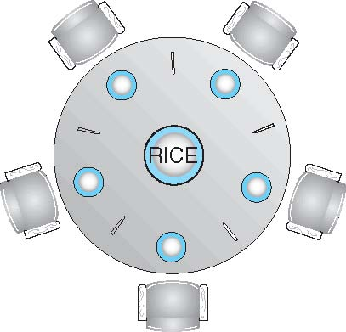
Dining-Philosophers Problem
Philosophers spend their lives alternating thinking and eating
Don’t interact with their neighbors, occasionally try to pick up 2 chopsticks (one at a time) to eat from bowl
Need both to eat, then release both when done
In the case of 5 philosophers
Shared data
Bowl of rice (data set)
Semaphore chopstick [5] initialized to 1 (all available)

Slide 38
Dining-Philosophers Problem Algorithm Structure of Philosopher i
do
{
wait (chopstick[i]);
wait (chopStick[ (i + 1) % 5] );
// eat
signal (chopstick[i] );
signal (chopstick[ (i + 1) % 5] );
// think
} while (TRUE);
Notes:
Mutual exclusion, but not deadlock prevention.

Slide 39
Problems with Algorithm
Deadlock is possible.
Allow at most 4 philosophers to be sitting simultaneously at the table.
Allow a philosopher to pick up the forks only if both are available (picking must be done in a critical section.
Use an asymmetric solution -- an odd-numbered philosopher picks up first the left chopstick and then the right chopstick. Even-numbered philosopher picks up first the right chopstick and then the left chopstick.
Notes:
4 philosophers sounds like cheating the problem.

Slide 40
Problems with Semaphores
Incorrect use of semaphore can result in deadlock and starvation. We expect a wait(mutex) followed by signal(mutex). One misbehaving process can break things.
Programming errors can occur easily because in some case the wait and signal calls can be in completely different areas of code, with various execution paths to get to them.

Slide 41
One Solution: Monitors
A high-level abstraction that provides a convenient and effective mechanism for process synchronization
Abstract data type, internal variables only accessible by code within the procedure
Only one process may be active within the monitor at a time
But not powerful enough to model some synchronization schemes
monitor monitor-name
{
// shared variable declarations
procedure P1 (…) { …. }
procedure Pn (…) {……}
Initialization code (…) { … }
}
}

Slide 42
Condition Variables
condition x, y;
Two operations are allowed on a condition variable:
x.wait() – a process that invokes the operation is suspended until x.signal()
x.signal() – resumes one of processes (if any) that invoked x.wait()
If no x.wait() on the variable, then it has no effect on the variable

Slide 43
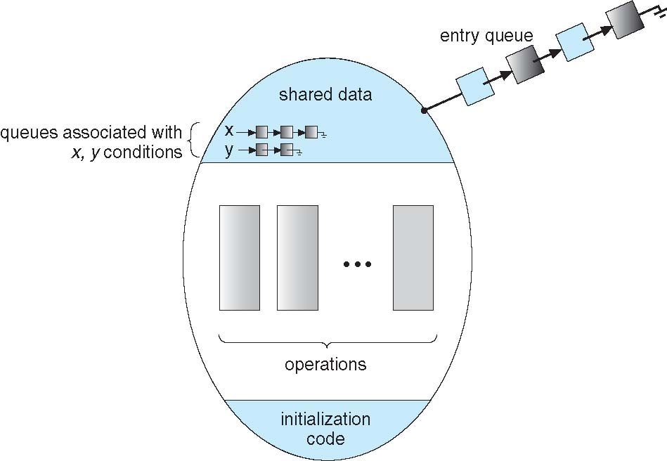
Monitor with Condition Variables

Slide 44
Condition Variables Choices
If process P invokes x.signal(), and process Q is suspended in x.wait(), what should happen next?
Both Q and P cannot execute in parallel. If Q is resumed, then P must wait
Options include
Signal and wait – P waits until Q either leaves the monitor or it waits for another condition
Signal and continue – Q waits until P either leaves the monitor or it waits for another condition
Both have pros and cons – language implementer can decide
Monitors implemented in Concurrent Pascal compromise
P executing signal immediately leaves the monitor, Q is resumed
Implemented in other languages including Mesa, C#, Java

Slide 45
Monitor Solution to Dining Philosophers
monitor DiningPhilosophers
{
enum { THINKING; HUNGRY, EATING) state [5] ;
condition self [5];
void pickup (int i)
{
state[i] = HUNGRY;
test(i);
if (state[i] != EATING)
self[i].wait;
}
void putdown (int i) {
state[i] = THINKING;
// test left and right neighbors
test((i + 4) % 5);
test((i + 1) % 5);
}
Notes:
Mutual exclusion
No deadlock
Still possible for starvation

Slide 46
Monitor Solution to Dining Philosophers (Continued)
void test (int i) {
if ((state[(i + 4) % 5] != EATING) &&
(state[i] == HUNGRY) &&
(state[(i + 1) % 5] != EATING) ) {
state[i] = EATING ;
self[i].signal () ;
}
}
initialization_code()
{
for (int i = 0; i < 5; i++)
{
state[i] = THINKING;
}
}
}

Slide 47
Monitor Implementation Using Semaphores
Variables
semaphore mutex; // (initially = 1) - monitor
semaphore next; // (initially = 0) – signalers
int next_count = 0;
Each procedure F will be replaced by
wait(mutex);
…
body of F;
…
if (next_count > 0)
signal(next)
else
signal(mutex);
Mutual exclusion within a monitor is ensured
Notes:
If monitor is free when enter function F.
If next

Slide 48
Monitor Implementation – Condition Variables
For each condition variable x, we have:
semaphore x_sem; // (initially = 0)
int x_count = 0;
The operation x.wait can be implemented as:
x_count++;
if (next_count > 0)
signal(next);
else
signal(mutex);
wait(x_sem);
x_count--;

Slide 49
Monitor Signal Implementation
The operation x.signal can be implemented as:
if (x_count > 0)
{
next_count++;
signal(x_sem);
wait(next);
next_count--;
}

Slide 50
Resuming Processes within a Monitor
If several processes queued on condition x, and x.signal() executed, which should be resumed?
FIFO frequently not adequate
conditional-wait construct of the form x.wait(c)
Where c is priority number
Process with lowest number (highest priority) is scheduled next

Slide 51
Alternative Approaches
Transactional Memory
OpenMP
Functional Programming Languages

Slide 52
Transactional Memory
A memory transaction is a sequence of read-write operations to memory that are performed atomically.
void update()
{
/* read/write memory */
}

Slide 53
OpenMP
OpenMP is a set of compiler directives and API that support parallel progamming.
void update(int value)
{
#pragma omp critical
{
count += value
}
}
The code contained within the #pragma omp critical directive is treated as a critical section and performed atomically.

Slide 54
Functional Programming Languages
Functional programming languages offer a different paradigm than procedural languages in that they do not maintain state.
Variables are treated as immutable and cannot change state once they have been assigned a value.
There is increasing interest in functional languages such as Erlang and Scala for their approach in handling data races.

